Slide 1
Eyeriss: An Energy-Efficient Reconfigurable Accelerator for Deep Convolutional Neural Networks
Presenter: Pengcheng Xu
Junior ECE
VE370 2021Su
2021/7/27

Slide 2
contents
1.system architecture
2.energy-efficient features
A.Energy-Efficient Dataflow: Row Stationary
1)1-D Convolution Primitive in a PE
2)2-D Convolution PE Set
3)Dimensions Beyond 2-D in PE Array
--(Multiple PE Sets in the PE Array)
B. Exploit Data Statistics
1)Run-length compres(RLC)
3.SYSTEM MODULES
A. Global Buffer
B. Network-on-Chip
1)Global Input Network
2)Global Output Network
3)Local Network
C. Processing Element and Data Gating
4.Experiment&Result
A. AlexNet
B. VGG-16
5.Conclusion

Slide 3
abstract
Why?
how?
result?
AI algorithm has achieved great success
brings challenges in throughput and energy efficiency to the hardware deployment.
Since most AI algorithms require a large amount of data handling (on-chip data transmission and off chip data transmission),
handling data is power-consuming, storage has become a special factor
eyeriss, has reconfigurable characteristics,
can adapt to convolution operations of various shapes and sizes.
structure of row station (RS), fully reuses the data, reduces the access to the off chip DRAM and improves the efficiency.
compresses and data gating the network to further improve the energy efficiency
Alexnet and VGG-16.
Alexnet : processing speed :35 FPS, memory access calculation ratio : 0.0029 DRAM access / multiply, power consumption :278 MW (batchsize = 4),
VGG-16：processing speed: 0.7 FPS, the memory access calculation ratio :0.0035 DRAM access / Mac, power consumption: 236 MW (batchsize = 3)

Slide 4
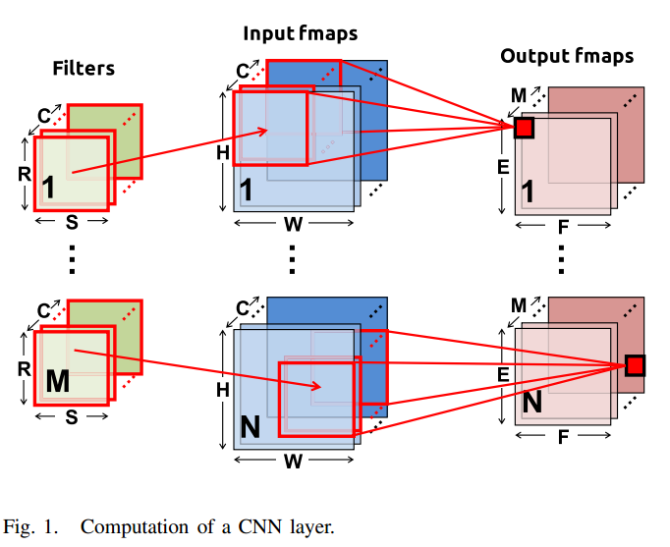
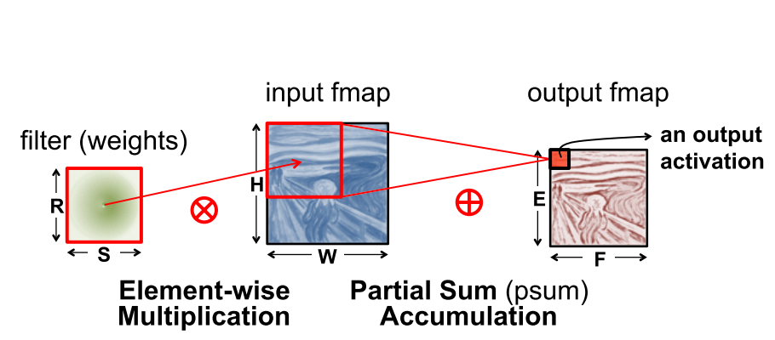
convolution
Blue
Green
Red

Slide 5
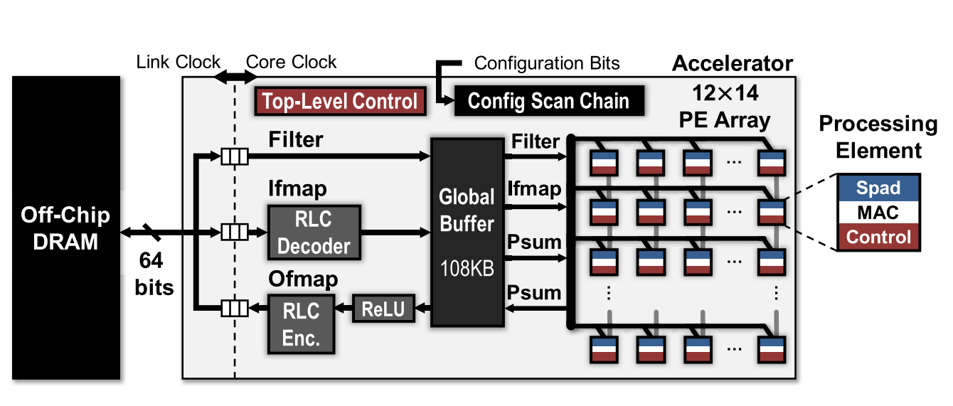
Eyeriss system architecture
Run-length compression (RLC)
PE scratch pads
multiply and
accumulations
Partial sum

Slide 6
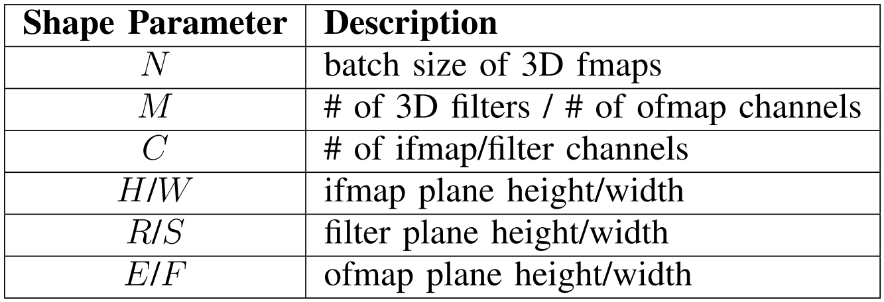
parameters

Slide 7
Main features
A spatial architecture using an array of 168 processing elements (PEs) that creates a four-level memory hierarchy.
A CNN dataflow, called Row Stationary (RS)
A network-on-chip (NoC) architecture
Run-length compression (RLC) and PE data gating

Slide 8
two clock domains:
1. Link clock is used to control the data transmission of on-chip storage and off chip DRAM.
2. Core clock is used to control the processing of system on chip.
The two clock domains are asynchronous, so they are independent of each other and exchange data through FIFO. In the core clock domain, the main structures include PE array, GLB, RLC codec and a relu module.
The storage layer of the whole system is divided into four layers, which are arranged in descending order of energy consumption, including the communication between DRAM, GLB and PE and the internal storage units (Spads) of PE. The control of the whole system is also divided into two levels.
The top-level control has the following three points
1. Data communication between DRAM and GLB
2. Communication between PE array and GLB through NOC
3. The operation of RLC codec and relu modules, and the bottom control is the internal control logic of PE, which also makes the operations between PES independent and do not need to be synchronized.

Slide 9
2.ENERGY-EFFICIENT FEATURES
Accelerators improve energy efficiency mainly from two aspects, namely
1. Reduce data transmission times
2. Statistics using data

Slide 10
A. Energy-Efficient Dataflow: Row Stationary
In eyeriss, the author proposes a dataflow structure row station (RS), which has good reconfigurable characteristics and can deal with multiple shape inputs. It also maximizes the reuse of data and reduces the data transmission, especially the access to off chip DRAM. In convolution operation, the forms of data reuse include:
1) Convolutional Reuse: Each filter weight is reused E × F
times in the same ifmap plane, and each ifmap pixel is usually reused R × S times in the same filter plane.
2) Filter Reuse: Each filter weight is reused across the batch of N ifmaps.
3) Ifmap Reuse: Each ifmap pixel is reused across M filters (to generate M ofmap channels).

Slide 11
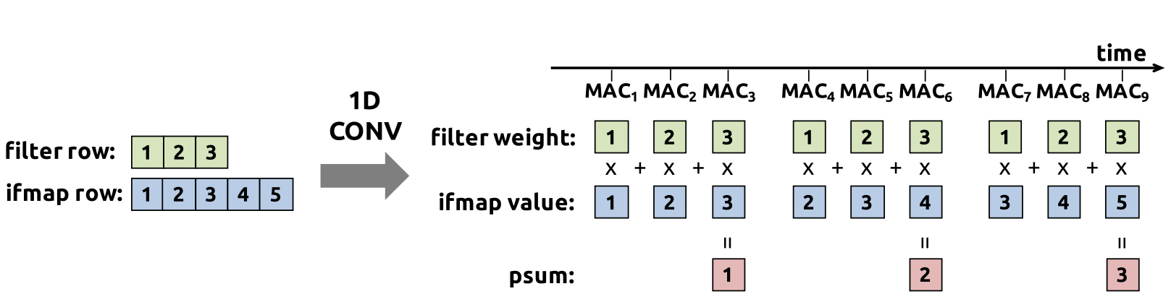
1-D Convolution Primitive in a PE
One dimensional convolution calculation unit, which divides the two-dimensional convolution operation into one-dimensional convolution between each line. The operation result of one-dimensional convolution is partial sum, and the corresponding partial sum of multiple lines can be added to obtain the final operation result. As shown in the figure below:
Fig. 3. Processing sequence of a 1-D convolution primitive in a PE. In this example, the filter row size ( S ) and the ifmap row size ( W ) are 3 and 5,respectively.

Slide 12
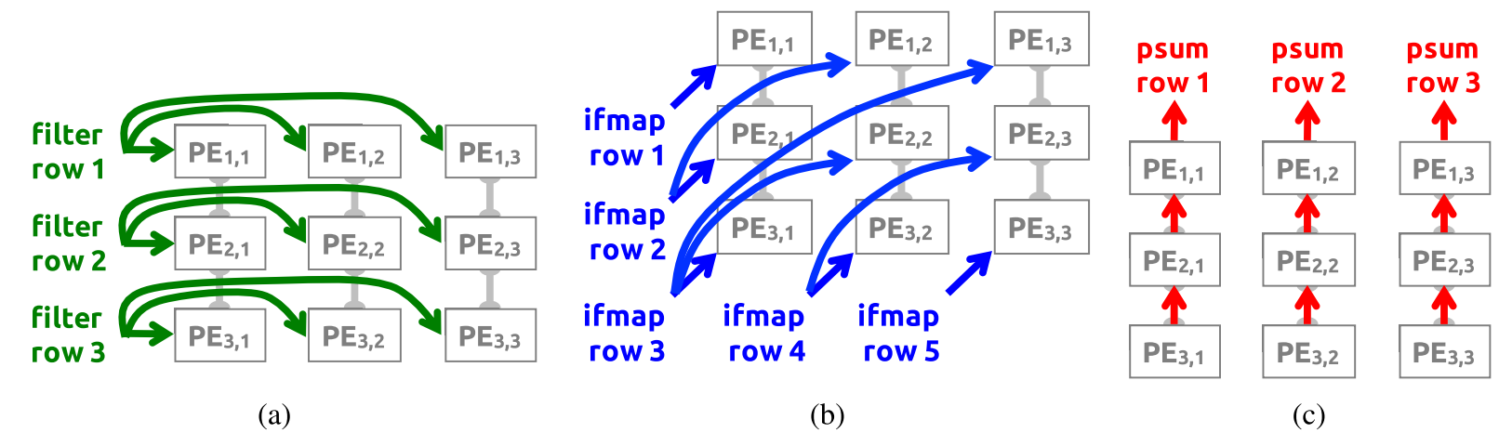
2-D Convolution PE Set
The two-dimensional convolution calculation unit is shown in the figure below. Taking the convolution calculation of 3x3 convolution kernel and 5x5 input features as an example, each row of convolution kernel is broadcasted to the corresponding PE unit in the horizontal direction, each row of input features is broadcasted to the corresponding unit in the diagonal direction, and the partial sum is summed in the vertical direction to obtain the final result. If the size of convolution kernel is RXR and the size of output characteristic graph is exe, the arrangement of PE array should be row R and column E.

Slide 13
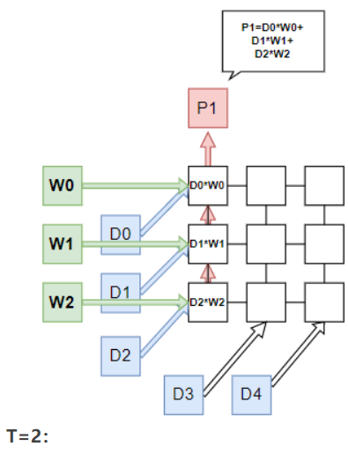
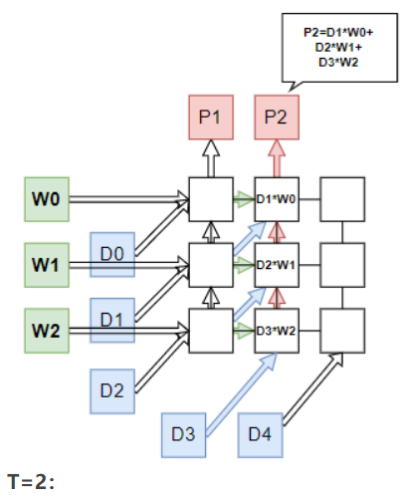
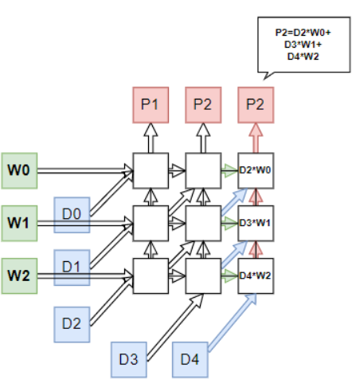
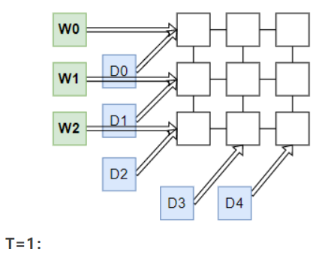

Slide 14
Dimensions Beyond 2-D in PE Array
Dimensions beyond 2-D in PE array.due to the existence of N, m and C, the actual convolution is not two-dimensional. Our method is to fix the two dimensions in the additional three-dimensional, and then only consider one dimension. In this way, there are three reuse modes:
different ifmapsreuse the same filter (i.e., filter reuse); (N)
2) different filters reusethe same ifmap (i.e., ifmap reuse); (M)
3) filters and ifmaps from different channels can accumulate their psums together (i.e., psum accumulation). (C)

Slide 15
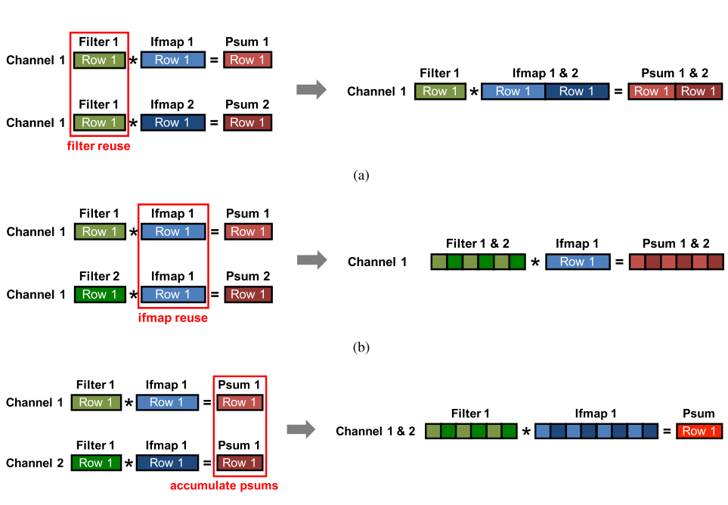
Dimensions Beyond 2-D in PE Array
As shown in the figure, it is the schematic diagram of three multiplexing modes. Different input features reuse the same convolution core. See (a), which can be realized only by splicing the lines of different input feature diagrams, while (b) and (c) are the schematic diagrams of multiplexing modes 2 and 3 respectively.

Slide 16
Dimensions Beyond 2-D in PE Array
There are two main ways to realize high-dimensional convolution:
Multiple 2-D Convolutions in a PE Set
Multiple PE Sets in the PE Array

Slide 17
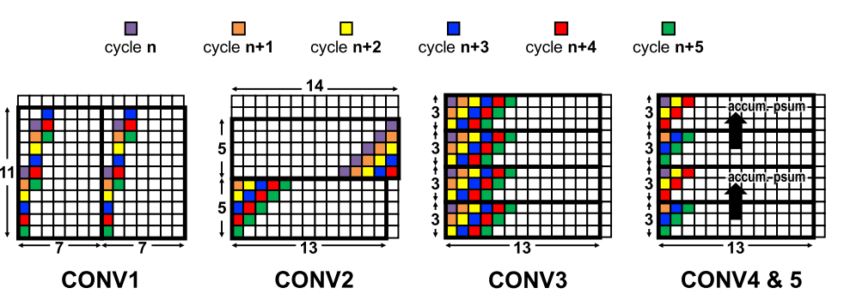
Multiple PE Sets in the PE Array
That is, multiple PE sets are used to realize high-dimensional convolution, which is easier to understand than the former, as shown in the following figure
Mapping of the PE sets on the spatial array of 168 PEs for the CONV layers in AlexNet.
For the colored PEs, the PEs with the same color receive the same ifmap value in the same cycle. The arrow between two PE sets indicates that their psums can be accumulated together.
Notes:
CONV1是一个S=4的11x11卷积，输出特征大小为55x55CONV2是一个S=1的5x5卷积，输出特征大小为27x27CONV3是一个 S=1的3x3卷积，输出特征大小为13x13CONV4&5是一个S=1的3x3卷积，输出特征大小为13x13对CONV1，由于步长为4，因此输入特征的行不再是按照对角线复用，而是在（x+1,y+4)位置复用，在CONV1中，共有两个PE Set，并且这两个PE Set的输入特征行相同，因此可以判断，这是输入特征被2个卷积核复用的情况。对CONV2，步长为1，输入特征的行按照对角线复用，共两个PE Set，并且上一个PE Set的最后四行和下一个PE Set的最开始四行相同，因此，可以判断，上边的PE Set计算输出特征图的前14行，而下边的PE Set计算输出特征的后13行。对CONV3，共四个PE Set，且每个Set的输入特征的行都一样，因此可以判断，这是同一个输入特征被4个卷积核复用。对CONV4&5，共四个PE，其中上边两个PE输入特征完全不同，可以判断为是输入特征的不同通道在进行计算，箭头则表示不同通道的部分和相加，而下边两个PE Set同上边两个情况完全相同，又能判断出有两个卷积核，因此这是M=2,C=2的情况。

Slide 18
Multiple PE Sets in the PE Array
Conv1 is a 11x11 convolution with S = 4, output characteristic size is 55x55
Conv2 is a 5x5 convolution with S = 1, output characteristic size is 27x27
Conv3 is a 3x3 convolution with S = 1, output characteristic size is 13x13
Conv4 & 5 is a 3x3 convolution with S = 1, output characteristic size is 13x13

Slide 19
B. Exploit Data Statistics
Although RS structure greatly reduces the number of data transmission and improves energy efficiency, in order to further optimize, the author also makes data statistics and excavates the optimization direction
Reduce access to off chip DRAM because access to DRAM is the most time-consuming and energy consuming storage system
Skip unnecessary calculations, such as the multiplication of and 0

Slide 20
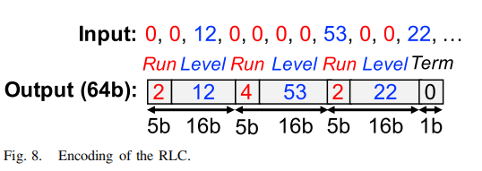
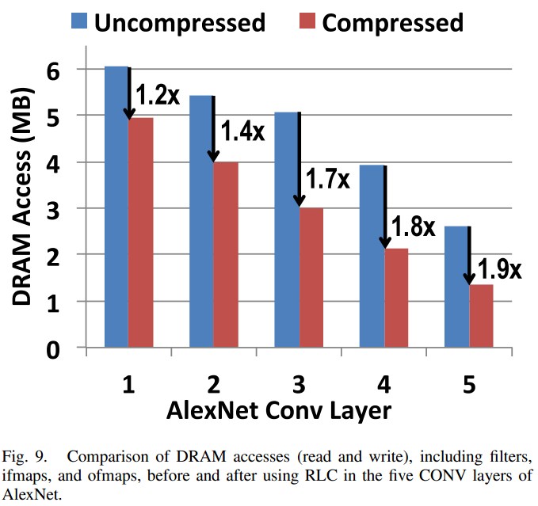
Run-length compression (RLC)
The author uses RLC method to reduce the storage of unnecessary zeros in the characteristic graph and reduce the demand for memory bandwidth. The figure above is the schematic diagram of RLC coding. Up to 31 consecutive zeros can be recorded by 5-bit data called run, and the next data is a 16 bit non-zero value called level, followed by run. Repeat this for 3 times, and the three pairs of run levels will be packaged into a 64 bit data, and the last 3 bits are used to indicate whether the end has been reached.
In this experiment, the author compares the access times of accelerator to DRAM before and after RLC coding, and obtains the following figure:
At the same time, the author points out that if the weight is also RLC coded, the compression effect will be better.

Slide 21
3.SYSTEM MODULES
Global Buffer
Network-on-Chip
1)Global Input Network
2)Global Output Network
3)Local Network
C. Processing Element and Data Gating

Slide 22
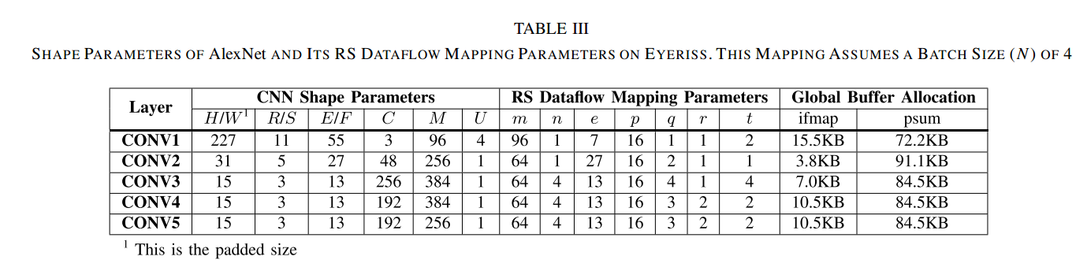
A.Global Buffer
Eyeriss has a 108KB GLB on-chip cache for asynchronous data transmission with DRAM. Through NOC and PE array communication, 100kb of the 108KB of GLB is used to store input features and output features (or partial sum) to support data reuse, while the remaining 8KB space is used to store weights. When PE array is processing data, GLB will preload the weights to be used in the next stage.

Slide 23
B. Network-on-Chip
NOC is used to schedule data transmission between PE and GLB and data transmission between PE to adapt to various shapes.
NOC generally consists of the following three parts:
1)Global Input Network
2)Global Output Network
3)Local Network

Slide 24
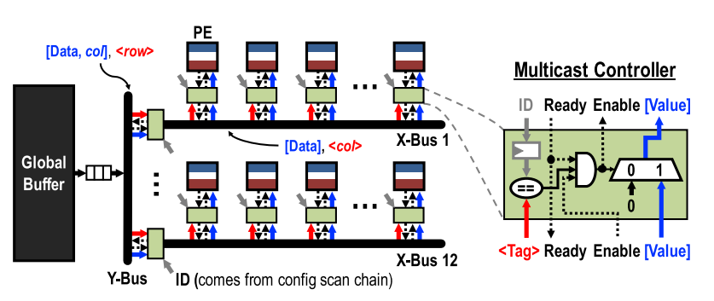
B.Network-on-Chip 1)Global Input Network

Slide 25
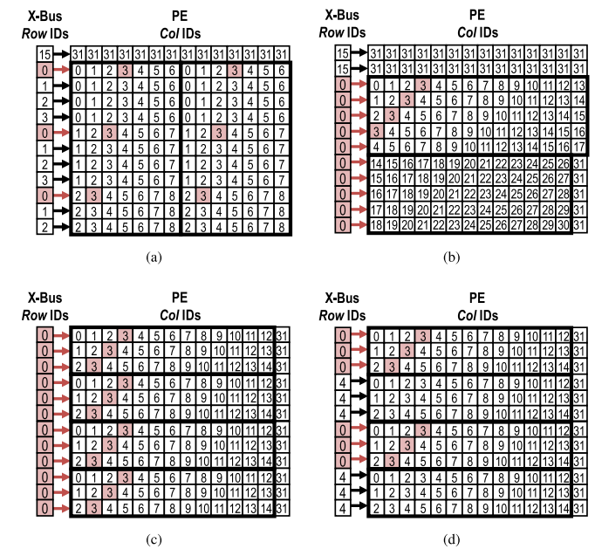
B.Network-on-Chip 1)Global Input Network
Fig. 11. row IDs of theX-busesand col IDs of the PEs for ifmap delivery using GIN in AlexNet layers.
(a) CONV1.
(b) CONV2.
(c) CONV3.
(d) CONV4 and CONV5.
In this example, assuming the tag on the data has row = 0 and col = 3, the X-buses and PEs in red are the activated buses
and PEs that receive the data, respectively.

Slide 26
Network-on-Chip
2)Global Output Network The function is the same as gin, but in the opposite direction.
3)Local Network Between adjacent PEs in two vertical directions, the PE at the bottom can transmit psum to the PE at the top, which is the main function of LN.

Slide 27
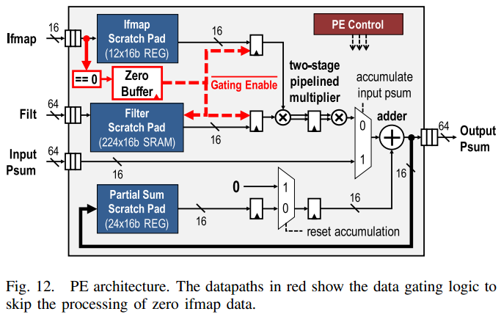
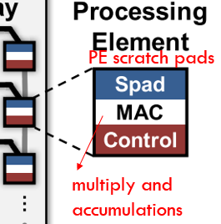
C. Processing Element and Data Gating

Slide 28
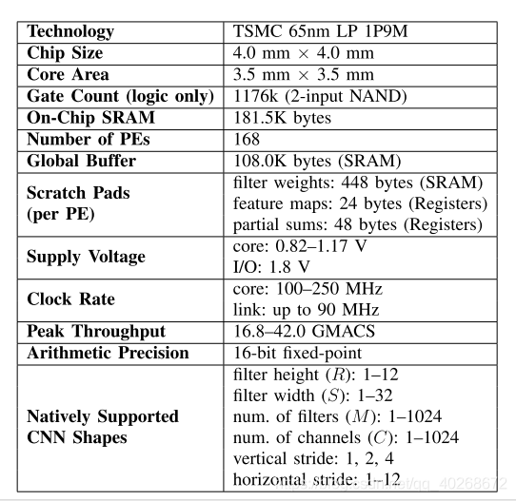
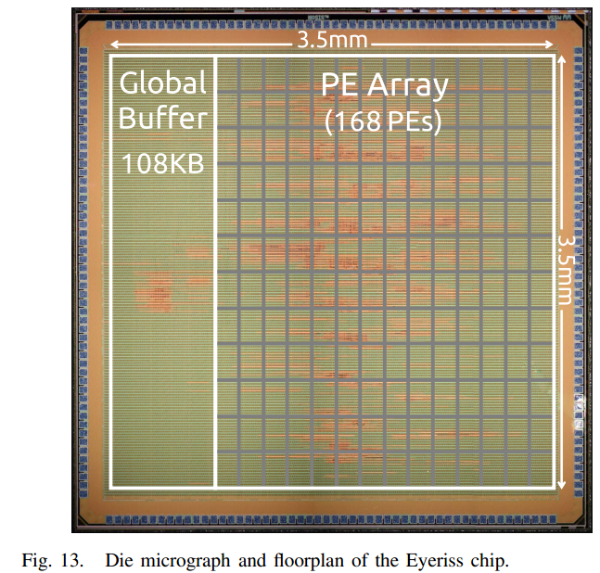
Experiment&Result
Eyeriss is realized by 65nm process.
The following figure shows the detailed characteristics of eyeriss.

Slide 29
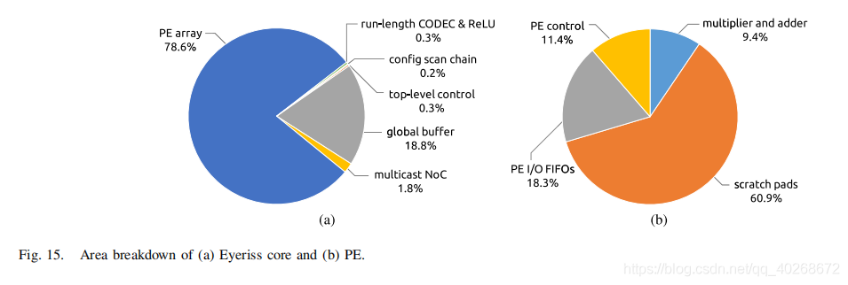
Experiment&Result
Figure a shows the area proportion of eyeriss core, and figure B shows the area proportion of each PE.It can be seen that scratch pads occupy most of the area of PE, while on-chip storage, including scratch pads and GLB, accounts for 2 / 3 of the total area of the chip, and multipliers and adders only account for 7.4% of the total area.
Then, the author conducted a benchmark test on two CNN models, Alex net and vgg-16, and the batch size was selected as 4 and 3 respectively.

Slide 30
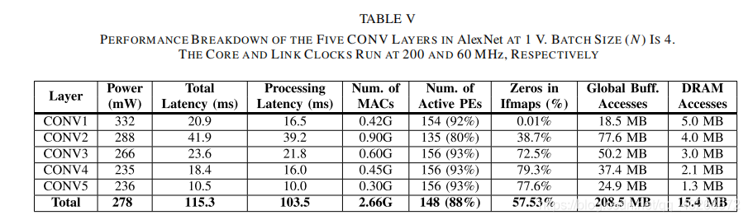
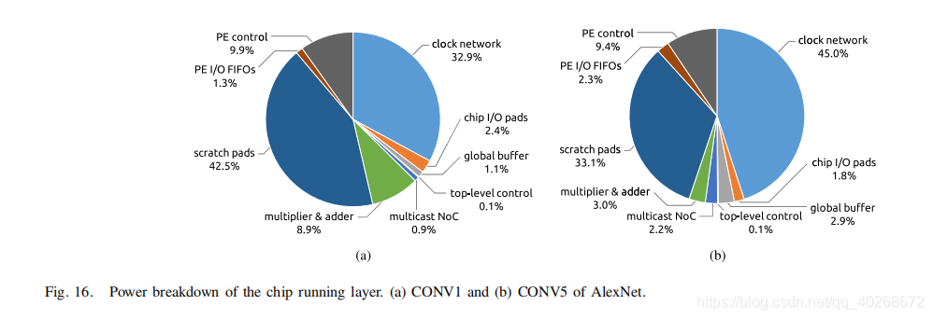
A. AlexNet

Slide 31
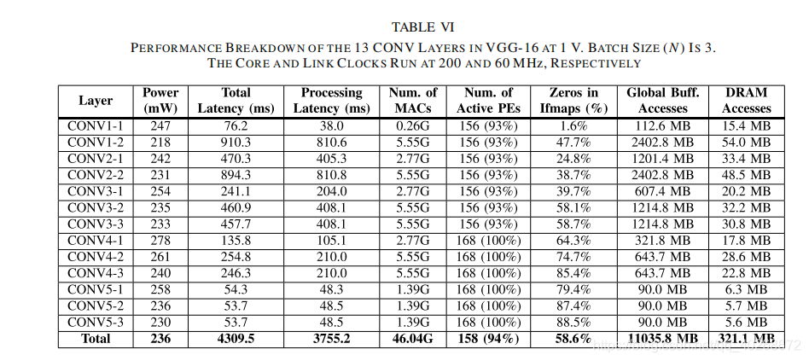
B. VGG-16
Table VI shows the performance of 13 layers in vgg-16 at 1V. On average, the accelerator frame rate is 0.7frames/s and the power consumption is 236mw.

Slide 32
Conclusion
Eyeriss proposed by the author makes full use of RS structure for data reuse;
Using data statistics, the 0 element is skipped during multiplication, which reduces the power consumption,
and RLC coding is used to reduce the demand for memory bandwidth.
Finally, eyeriss achieved good results on alexnet and VGG-16.

Slide 33
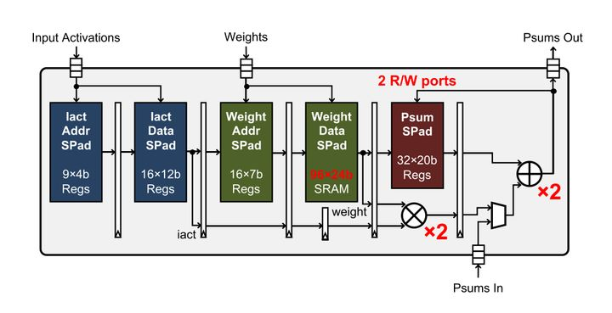
Limitation and critiques
For compact DNN, the hardware design faces two problems:
The preselected data will decrease with the change of DNN, resulting in the decrease of PE array utilization.
Less data reuse requires higher data bandwidth.
For sparse DNN, there are also two problems:
When skipping the zero element, it is difficult to judge whether the weight and input are 0 at the same time under RLC coding
PE resources are unevenly distributed. It is possible that most data operations will be deployed to a small number of PES, and the remaining PES are idle
In order to solve the above problems, eyeriss v2 makes the following three main contributions:
A NOC is designed to provide high bandwidth under the condition of low data reuse and try not to let PE idle
The newly designed PE is more suitable for compact and sparse DNN
The new accelerator eyeriss V2 runs mobilenet 12.6 times faster than eyeriss and consumes 2.5 times less power

Slide 34
references
[1]Y.-H. Chen, T. Krishna, J. Emer, and V. Sze,
“Eyeriss: An energy-efficient recon figurable accelerator for deep convolutional neural networks,” IEEE J. Solid-State Circuits , vol. 51, no. 1, pp. 127–138, Jan. 2017.
[2] DNN Energy Estimation. [Online]. Available: http://eyeriss.mit.edu/energy.html
[3] Benchmarking DNN Processors . [Online]. Available: Http://eyeriss.mit.edu/benchmarking.html

Slide 35
Thank you!

